Slide 1
IT694 Week 14_Lec 1 Computer Networks
Carrier Sense Multiple Access

Slide 2
Slotted ALOHA
Send as you wish
Wait for time slot
Take a chance and send
If collision, wait OR send

Slide 3
CSMA (carrier sense multiple access)
simple CSMA: listen before transmit:
if channel sensed idle: transmit entire frame
if channel sensed busy: defer transmission
CSMA/CD: CSMA with collision detection
collisions detected within short time
colliding transmissions aborted, reducing channel wastage
collision detection easy in wired, difficult with wireless

Slide 4
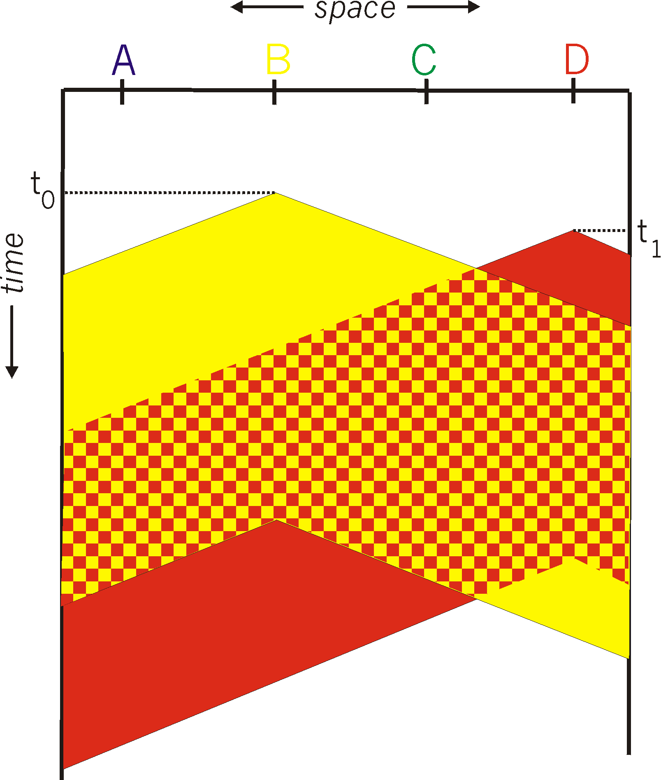

CSMA: collisions
spatial layout of nodes
collisions can still occur with carrier sensing:
propagation delay means two nodes may not hear each other’s just-started transmission
collision: entire packet transmission time wasted
distance & propagation delay play role in in determining collision probability

Slide 5
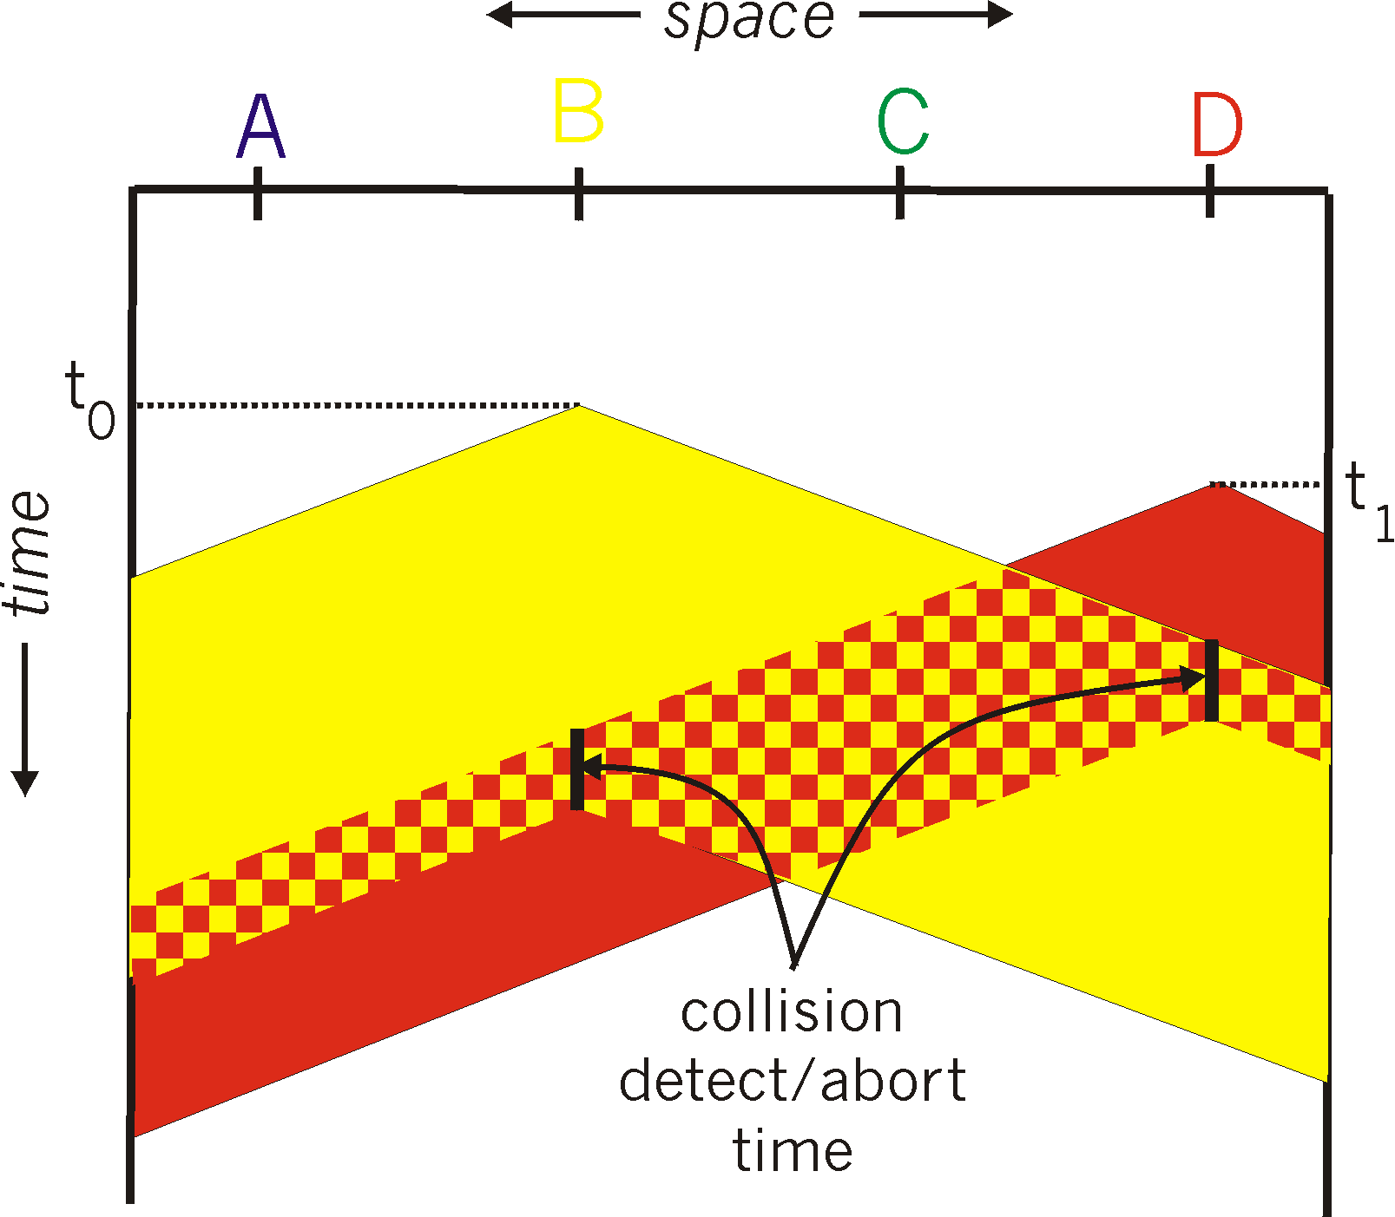
CSMA/CD:
spatial layout of nodes
CSMA/CD reduces the amount of time wasted in collisions
transmission aborted on collision detection

Slide 6
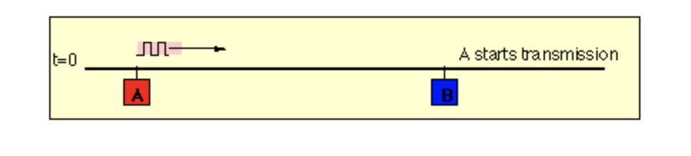
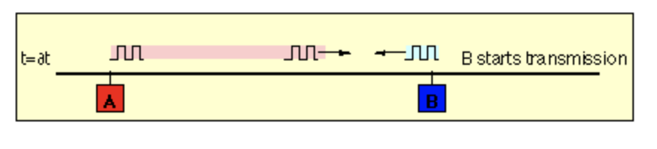
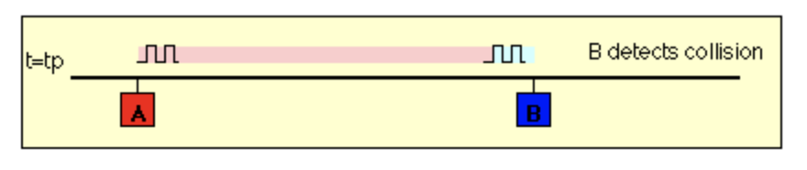
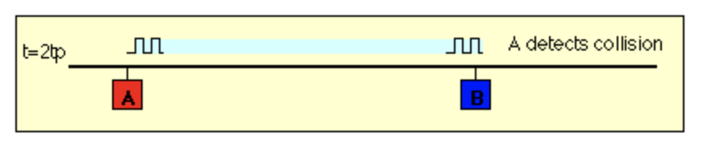

Slide 7
CSMA/CD algorithm
If received datagram from network layer, create frame
Sense channel:
if idle: start frame transmission.
if busy: wait until channel idle, then transmit
If entire frame transmitted without collision - done!
If another transmission detected while sending: abort, send jam signal
After aborting, enter binary (exponential) backoff:
after mth collision, chooses K at random from {0,1,2, …, 2^{m}-1}. Ethernet waits K·51.2 micro secs, returns to Step 2
more collisions: longer backoff interval
Notes:
For Ethernet, the actual amount of time a node waits is K # 512 bit times (i.e., K times the amount of time needed to send 512 bits into the Ethernet) and the maxi- mum value that n can take is capped at 10.

Slide 8
K = 0, immediate transmission
k=1, wait 512 bit times
2nd collision, K={0, 1, 2,3}, This corresponds to a wait selected from {0, 51.2, 102.4, 153.6} micro seconds.

Slide 9
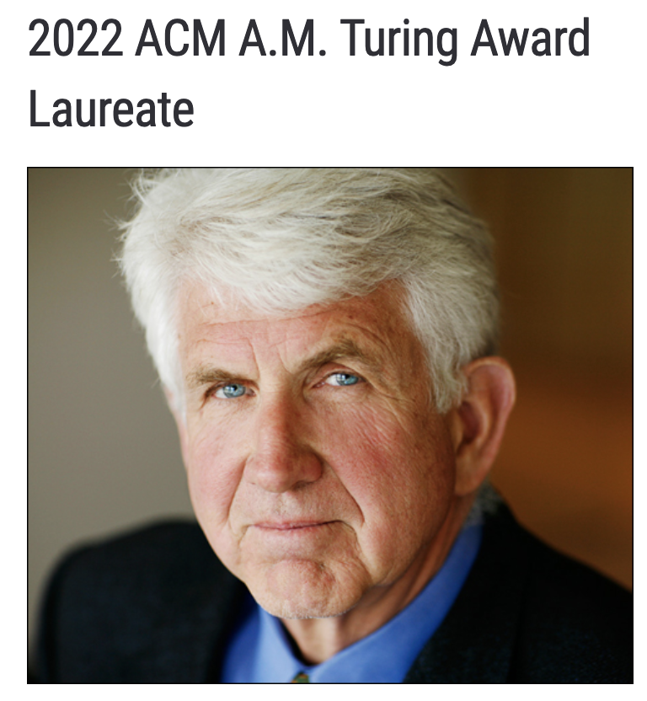
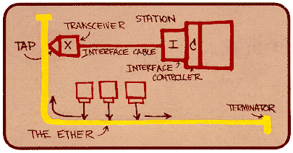
Ethernet
“dominant” wired LAN technology:
first widely used LAN technology
simpler, cheap
kept up with speed race: 10 Mbps – 400 Gbps
single chip, multiple speeds (e.g., Broadcom BCM5761)
Bob Metcalfe: Ethernet co-inventor,
2022 ACM Turing Award recipient
Metcalfe’s Ethernet sketch
https://www.uspto.gov/learning-and-resources/journeys-innovation/audio-stories/defying-doubters

Slide 10


Ethernet: physical topology
bus: popular through mid 90s
all nodes in same collision domain (can collide with each other)
switched: prevails today
active link-layer 2 switch in center
each “spoke” runs a (separate) Ethernet protocol (nodes do not collide with each other)
bus: coaxial cable
switched

Slide 11
Ethernet frame structure
sending interface encapsulates IP datagram (or other network layer protocol packet) in Ethernet frame
type
preamble
dest.
address
source
address
data (payload)
CRC
preamble:
used to synchronize receiver, sender clock rates
7 bytes of 10101010 followed by one byte of 10101011

Slide 12
Ethernet frame structure (more)
type
preamble
dest.
address
source
address
data (payload)
CRC
addresses: 6 byte source, destination MAC addresses
if adapter receives frame with matching destination address, or with broadcast address (e.g., ARP packet), it passes data in frame to network layer protocol
otherwise, adapter discards frame
type: indicates higher layer protocol
mostly IP but others possible, e.g., Novell IPX, AppleTalk
used to demultiplex up at receiver
CRC: cyclic redundancy check at receiver
error detected: frame is dropped

Slide 13
802.3 Ethernet standards: link & physical layers
many different Ethernet standards
common MAC protocol and frame format
different speeds: 2 Mbps, ... 100 Mbps, 1Gbps, 10 Gbps, 40 Gbps, 80 Gbps
different physical layer media: fiber, cable
application
transport
network
link
physical
MAC protocol
and frame format
100BASE-TX
100BASE-T2
100BASE-FX
100BASE-T4
100BASE-SX
100BASE-BX
copper (twister pair) physical layer
fiber physical layer

